Slide 1
Dataset proposals
Machine Learning
Norman Juchler

Slide 2
Goal of the project
Implement an entire machine learning pipeline
Problem formulation and data description
Exploratory data analysis and data visualization
Method selection and model training
Model testing and performance analysis
Discussion
Types of problems
Supervised learning
Unsupervised learning
Dimensionality reduction

Slide 3
Rules for the project work
Each student works on a different dataset!
The project is implemented entirely in a single Jupyter notebook
The submission consists of a ZIP folder containing
a functional Jupyter notebook
a PDF version of the notebook with all its output
data and other resources used
Note: The size of the submission (including data) must not exceed 50MB
The project must be individual work
Copying an existing notebook is not permitted.
You may have to answer individual questions about your project.

Slide 4
Hints
Choose a “relevant” problem
Choose a “solvable” problem
Ideas to find public datasets:
Kaggle
Google dataset search
Open data portal (Bundesamt für Statistik)
List of datasets for ML (Wikipedia)
...

Slide 5
Proposals

Slide 6
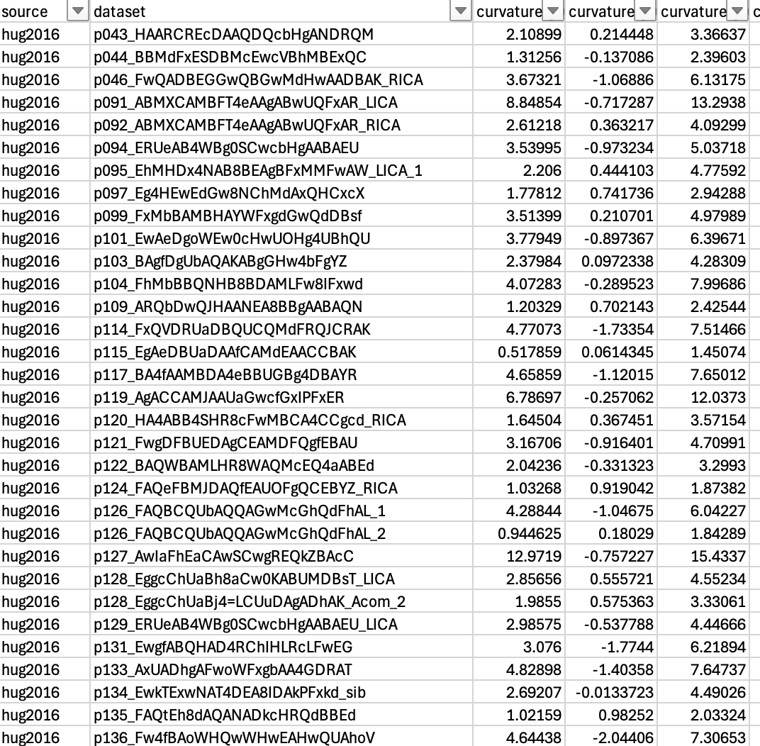
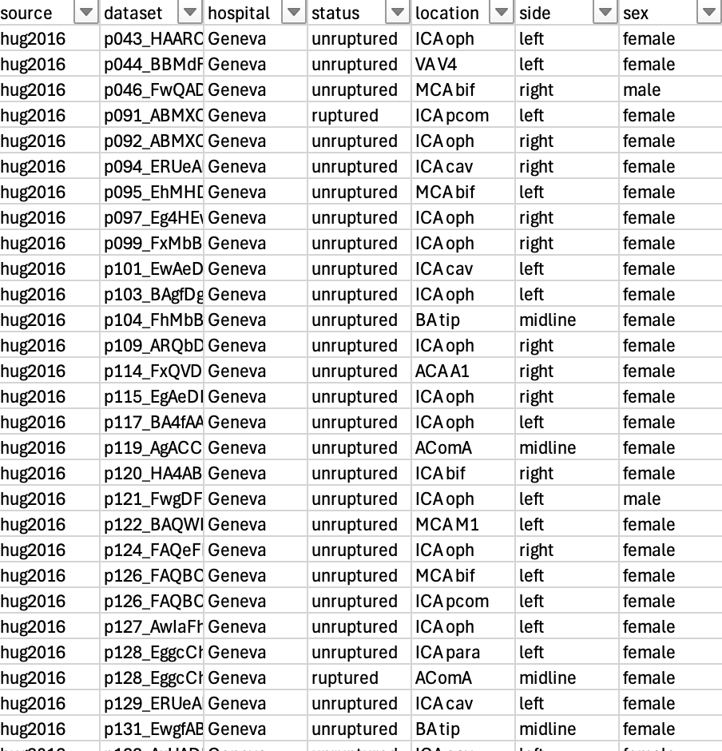
Nebuchadnezzar Juklerassar
Dataset / project name: Distinguish between dangerous and benign aneurysms based on their shape
Brief description: Aneurysms are pathologic dilations of (cerebral) arteries that may rupture and cause a bleeding in the brain. Being able to predict the rupturing of an aneurysm could safe lives!
Type of problem: Dimensionality reduction and supervised learning
Type of data: Features X: numerical descriptions of the aneurysm shape. Target labels y: Rupture status
Dataset in numbers: 750 aneurysms, 170 precomputed features
Online source: https://zenodo.org/records/6678442
Shape features (top) and clinical parameters about the cases

Slide 7
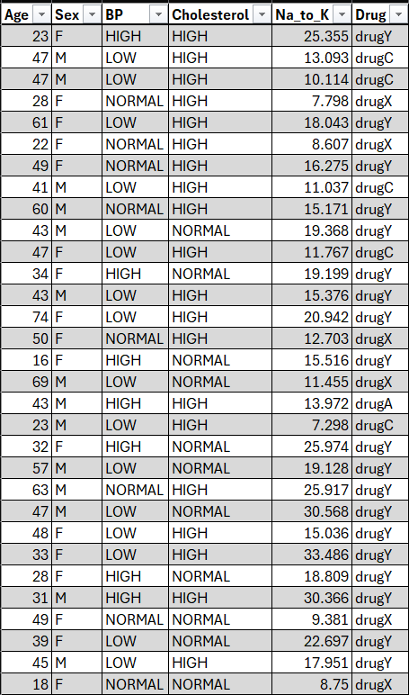
Hermann Elisabeth
Dataset / project name: Vorhersage von Medikamentenverschreibungen basierend auf Patienteneigenschaften
Brief description: Das Ziel ist es, das am besten geeignete Medikament, für einen Patienten vorherzusagen, basierend auf individuellen Merkmalen wie Geschlecht, Blutdruck, Cholesterinspiegel und dem Natrium-Kalium-Verhältnis im Blut.
Type of problem: Überwachtes Lernen (Klassifikation)
Type of data: Merkmale X: numerische und kategorische Patientenmerkmale, Zielvariable Y: Verschriebenes Medikament (Drug A, B, C, X, Y).
Dataset in numbers: 200 Patienten, 5 Merkmale, 5 Medikamente
Online source: Drugs A, B, C, X, Y for Decision Trees (kaggle.com)

